Slide 1
CS2100 Tutorial 4
Datapath
(Note: I'm very sick so another TA will teach this class with (most likely) not this set of slides)
Slides by Theodore, adapted from Prof. Aaron’s slides

Slide 2
Overview
Q1) Counting number of instructions
Q2) Pseudo-instructions implementation
Q3) Encoding MIPS instructions
Q4) MIPS Datapath
Q5) (Extra) GPU vs CPU

Slide 3
Q1. Number of Instructions
An ISA has 16-bit instructions and 5-bit addresses; two classes of instructions: A has one address; B has two addresses.
Both classes exist, and encoding space is fully utilized.
Bonus:
What happens if we don't stipulate both classes existing?
What happens if we don't need the encoding space to be fully utilized?

Slide 4
Q1. Number of Instructions
An ISA has 16-bit instructions and 5-bit addresses; two classes of instructions: A has one address; B has two addresses.
Both classes exist, and encoding space is fully utilized.
(a) What is the minimum total number of instructions?
11-bit opcode
address
Class A: ppppppppppp xxxxx
Class B: qqqqqq xxxxx yyyyy
6-bit opcode
address
address

Slide 5
Q1. Number of Instructions
An ISA has 16-bit instructions and 5-bit addresses; two classes of instructions: A has one address; B has two addresses.
Both classes exist, and encoding space is fully utilized.
(a) What is the minimum total number of instructions?
11-bit opcode
address
Class A: ppppppppppp xxxxx
Class B: qqqqqq xxxxx yyyyy
6-bit opcode
address
address
Answer: 95

Slide 6
Q1. Number of Instructions
An ISA has 16-bit instructions and 5-bit addresses; two classes of instructions: A has one address; B has two addresses.
Both classes exist, and encoding space is fully utilized.
(a) What is the maximum total number of instructions?
11-bit opcode
address
Class A: ppppppppppp xxxxx
Class B: qqqqqq xxxxx yyyyy
6-bit opcode
address
address

Slide 7
Q1. Number of Instructions
An ISA has 16-bit instructions and 5-bit addresses; two classes of instructions: A has one address; B has two addresses.
Both classes exist, and encoding space is fully utilized.
(a) What is the maximum total number of instructions?
11-bit opcode
address
Class A: ppppppppppp xxxxx
Class B: qqqqqq xxxxx yyyyy
6-bit opcode
address
address
Answer: 2017

Slide 8
Q2. Pseudo-instruction implementation
Several pseudo-instructions available
Check the MIPS sheet!
Can't use in exam, except when explicitly allowed
Question: how is it actually implemented?

Slide 9
Q2. Pseudo-instruction implementation
bgt $r1, $r2, L
[Live demo: QtSpim]
Note: We can't use $r1 and $r2 in QtSpim! Substitute with other registers, e.g. $t0, $t1
Note 2: Keep $r1, $r2, and L as-is in your final answer.
Don't change it to other register / label names.

Slide 10
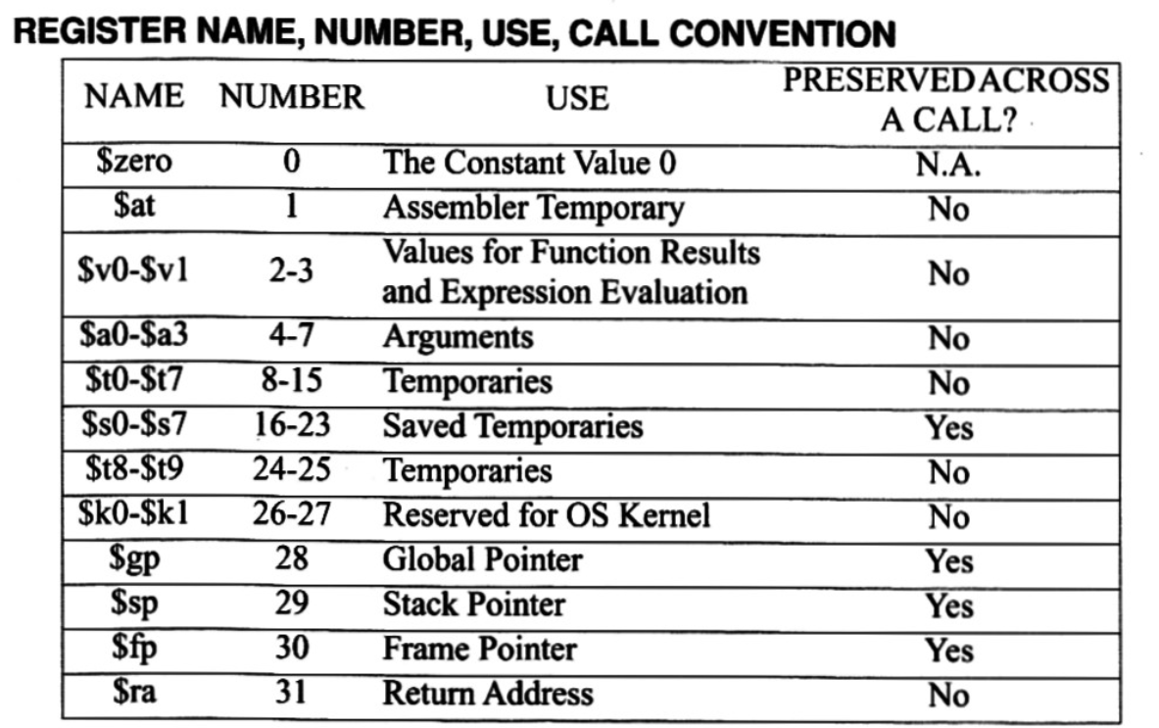
Q2. Pseudo-instruction implementation
bgt $r1, $r2, L
= blt $r2, $r1, L
Note: While $at is used in QtSpim, we will consider your answer correct with any other register.
User Text Segment [00400000]..[00440000]
[00400000] 0128082a slt $1, $9, $8 ; 1: bgt $t0, $t1, e [00400004] 14200001 bne $1, $0, 4 [e-0x00400004]
$1 is $at (Assembler Temporary)
Answer:
slt $at, $r2, $r1
bne $at, $zero, L

Slide 11
Q2. Pseudo-instruction implementation
(b) bge $r1, $r2, L

Slide 12
Q2. Pseudo-instruction implementation
(b) bge $r1, $r2, L
Idea: if($r1 >= r2) ==> if(!($r1 < $r2))

Slide 13
Q2. Pseudo-instruction implementation
(b) bge $r1, $r2, L
Idea: if($r1 >= r2) ==> if(!($r1 < $r2))
From (a):
blt $r1, $r2, L
is equivalent to
slt $at, $r1, $r2
bne $at, $zero, L

Slide 14
Q2. Pseudo-instruction implementation
(b) bge $r1, $r2, L
Idea: if($r1 >= r2) ==> if(!($r1 < $r2))
From (a):
blt $r1, $r2, L
is equivalent to
slt $at, $r1, $r2
bne $at, $zero, L
Idea 2: "negating" bne becomes beq
Answer:
slt $at, $r2, $r1
beq $at, $zero, L

Slide 15
Q2. Pseudo-instruction implementation
(c) ble $r1, $r2, L

Slide 16
Q2. Pseudo-instruction implementation
(c) ble $r1, $r2, L
Idea:
if ($r1 < $r2)
=> if ($r2 >= $r1)
=> if (!($r2 < $r1))

Slide 17
Q2. Pseudo-instruction implementation
(c) ble $r1, $r2, L
Idea:
if ($r1 < $r2)
=> if ($r2 >= $r1)
=> if (!($r2 < $r1))
From (a):
blt $r2, $r1, L
is equivalent to
slt $at, $r2, $r1
bne $at, $zero, L
"negating" bne becomes beq
Answer:
slt $at, $r1, $r2
beq $at, $zero, L

Slide 18
Q2. Pseudo-instruction implementation
(d) li $r, imm
Thing to note: imm here can be any 32-bit number

Slide 19
Q2. Pseudo-instruction implementation
(d) li $r, imm
Thing to note: imm here can be any 32-bit number
Scenario 1: the number is 0-65535 (fits within 16 bits)
Answer:
ori $r, $zero, imm

Slide 20
Q2. Pseudo-instruction implementation
(d) li $r, imm
Thing to note: imm here can be any 32-bit number
Scenario 2: the number can't fit within 16 bits
Answer: lui + ori (see: previous tutorial)
Note:
The assembler will parse the imm value.
Try the following:
li $t0, 2100
li $t1, 4294967295
li $t2, -1

Slide 21
Q2. Pseudo-instruction implementation
(d) nop

Slide 22
Q2. Pseudo-instruction implementation
(d) nop
Answer: 0000 0000 0000 0000 0000 0000 0000 0000

Slide 23
Q2. Pseudo-instruction implementation
(d) nop
Answer: 0000 0000 0000 0000 0000 0000 0000 0000
See MIPS reference sheet: this is an sll instruction
opcode
funct

Slide 24
Q2. Pseudo-instruction implementation
(d) nop
Answer: 0000 0000 0000 0000 0000 0000 0000 0000
See MIPS reference sheet again: sll $zero, $zero, 0
rs
rt
rd
shamt
Note:
Why do we need a nop operation?
Answer in pipelining section of the course

Slide 25
Q3. MIPS Encoding
(a) beq $1, $3, 0x12

Slide 26
Q3. MIPS Encoding
(a) beq $1, $3, 0x12
Answer: 0x1023000C

Slide 27
Q3. MIPS Encoding
(b) lw $24, 0($15)

Slide 28
Q3. MIPS Encoding
(b) lw $24, 0($15)
Answer: 0x8DF80000

Slide 29
Q3. MIPS Encoding
(c) sub $25, $20, 0x5

Slide 30
Q3. MIPS Encoding
(c) sub $25, $20, 0x5
Answer: 0x0285C822

Slide 31
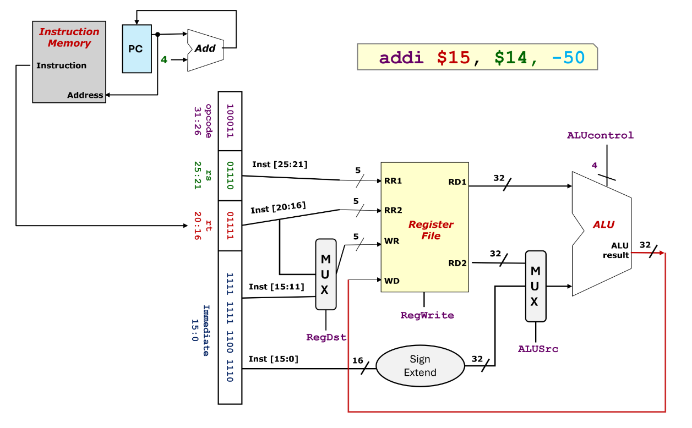
Q4. MIPS Datapath
Q: Draw the MIPS datapath for addi $15, $14, -50

Slide 32
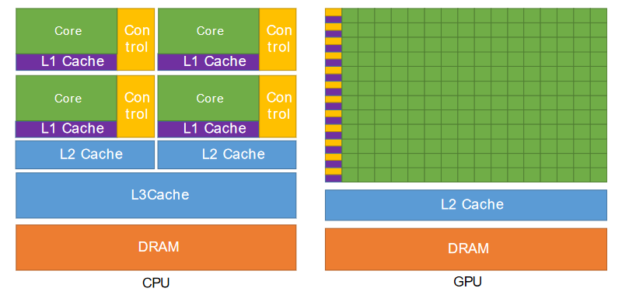
Q5. CPUs vs GPUs
Architecture-wise, not much difference!
Still Fetch-Decode-Execute cycle
Difference: multiple cores can have the same datapath for fetch+decode
image credits: https://docs.nvidia.com/cuda/archive/11.2.0/pdf/CUDA_C_Programming_Guide.pdf

Slide 33
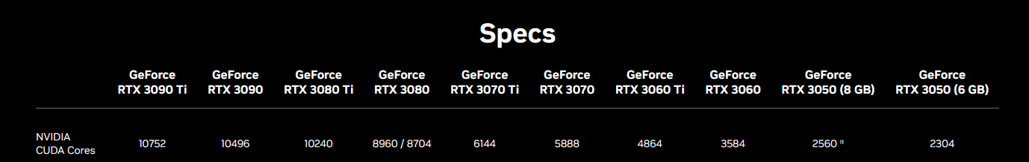
Q5. CPUs vs GPUs
Architecture-wise, not much difference!
Usage difference:
CPU can handle complex tasks, but has less parallel capabilities
Your machine probably has somewhere between 8 to 64 cores
Try the 'lstopo --of ascii' command to see nice graphics
GPU handles simpler workloads but massively more parallel
10+k cores is not unheard of. (Image source: https://www.nvidia.com/en-gb/geforce/graphics-cards/30-series/)
Each group of 32/64 cores does the same thing on different data – each core have their own register

Slide 34

End of Tutorial 4
Slides uploaded on github.com/theodoreleebrant/TA-2425S1
Email: theo@comp.nus.edu.sg
Anonymous feedback:
bit.ly/feedback-theodore
(or scan on the right)
(Also reminder for me to take attendance)

